Slide 1
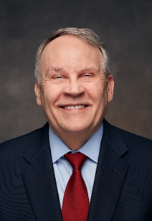
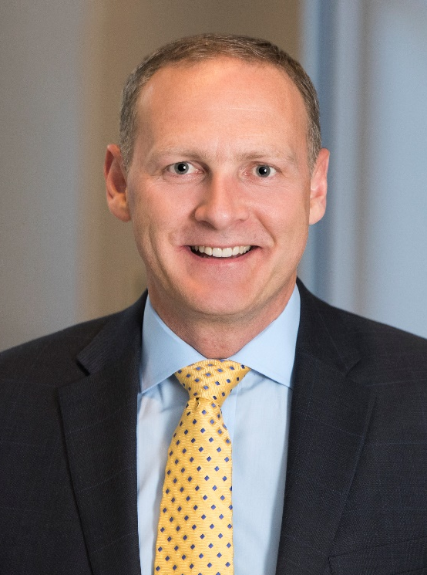
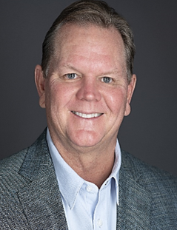
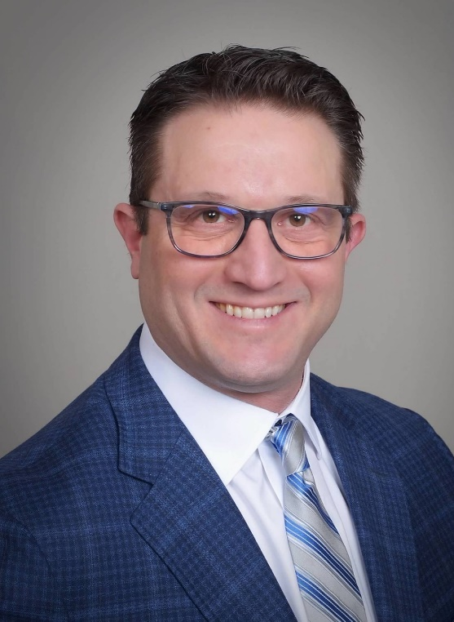
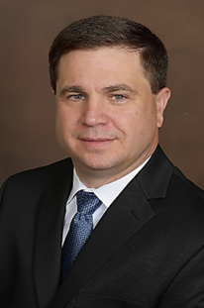
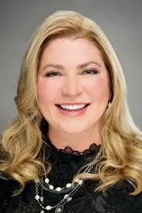
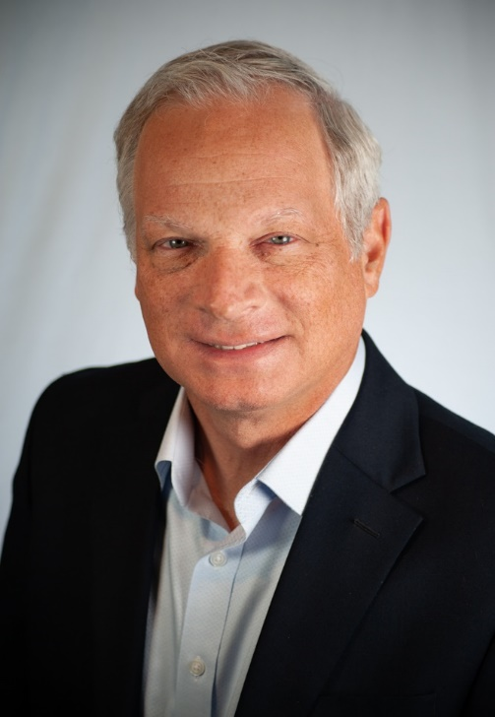
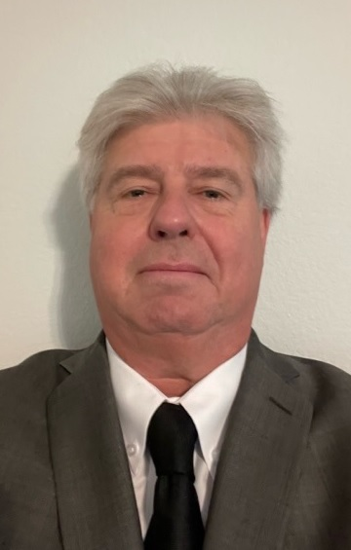
AZZ Executive Officers
Tom Ferguson
President and Chief Executive Officer
Jason Crawford
Chief Financial Officer
Bryan Stovall
President & Chief Operating Officer
Metal Coatings
Jeff Vellines
President & Chief Operating Officer
Precoat Metals
Kurt Russell
Senior Vice President &
Chief Strategic Officer Precoat Metals
Tara Mackey
Chief Legal Officer and Corporate Secretary
David Nark
Chief Marketing,
Communications,
and
Investor Relations Officer
Chris Bacius
Vice President
Business Development

