Slide 1
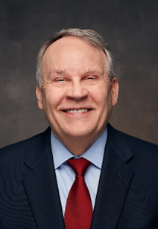
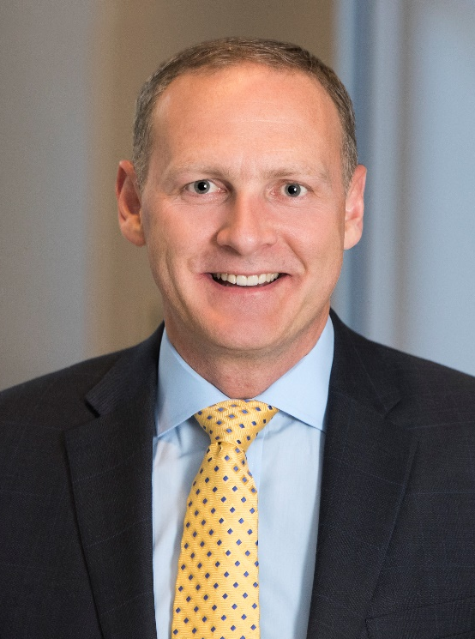
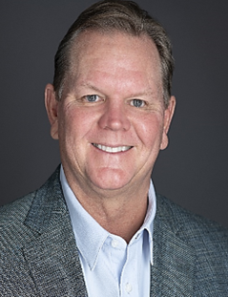
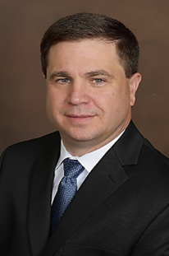
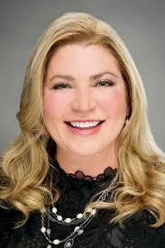
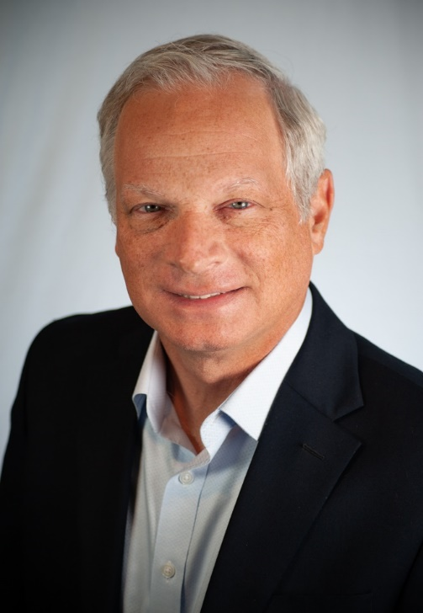
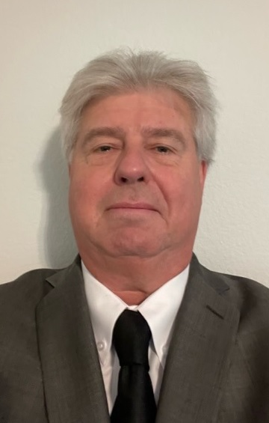
AZZ Executive Officers
Tom Ferguson
President and Chief Executive Officer
Jason Crawford
Chief Financial Officer
Bryan Stovall
President & Chief Operating Officer
Metal Coatings
Kurt Russell
Chief Operating Officer Precoat Metals
Tara Mackey
Chief Legal Officer and Corporate Secretary
David Nark
Chief Marketing,
Communications,
and
Investor Relations Officer
Chris Bacius
Vice President
Business Development

